Slide 1
Protecting Immigrant Households: Policies and Laws in Illinois
Anna Arzuaga
Housing Policy Analyst
Latino Policy Forum
Nina Sedeño
Immigration Policy Analyst
Latino Policy Forum
Notes:
My name is Fanny Lopez Benitez and I am Civic Engagement Manager at the Forum. Today, I will share information about the housing protections and resources available for immigrant tenants in IL. Please know that I am not a lawyer. I am only providing information that been verified by lawyers. If you have legal questions please contact one of the legal organizations that I will mention at the end of this video.

Slide 2
Notes:
This presentation is presented by the latino policy forum. We work to improve education outcomes, advocate for affordable housing, promote just immigration policies and strengthen community leadership.

Slide 3
Agenda
The Housing Rights for Immigrant Tenants Handbook
Fair Housing Protections Against Discrimination
Immigration Status Disclosure
Immigrant Tenant Protection Act (ITPA)
Public Charge
Resources
Notes:
Por ley, en IL todas las personas tienen derechos básicos de vivienda.
Muchos inquilinos inmigrantes asumen que no tienen derechos de vivienda. Sin embargo, tienen una serie de protecciones disponibles. Primero, los inquilinos inmigrantes deben saber que es ilegal que los propietarios exijan pagos y documentación adicionales… mientras que el estatus migratorio no es una clase protegida bajo las leyes de vivienda justa, el origen nacional está protegido. Algunos inquilinos inmigrantes pueden sufrir discriminación basada en su estatus migratorio que también esta relacionado con su origen nacional y aun podrían recibir protección bajo las leyes de vivienda justa.

Slide 4
Housing Rights for Immigrant Tenants Handbook
Notes:
The ITHB provides information on housing rights, responsibilities, and protections for both tenants and landlords. The handbook covers general housing protections under Illinois state law, as well as local and county level ordinances for a number of local jurisdictions that have them. The aim of the handbook is to provide a one-stop shop resources for both tenants and landlords to refer to when having questions about issues regarding a rental property and rental agreements. We hope this handbook will serve as a resource to help educate the community. We want tenants to know their responsibilities as renters and how to protect themselves and their housing stability and landlords know their obligations

Slide 5
Topics Covered in Housing Rights for Immigrant Tenants Handbook
General Housing Rights
Responsibilities for Landlords
Lockouts & Evictions
Fair Housing Rights
Immigrant Tenant Protection Act
Interpretation & Translation services
Public Charge Rule
Resources
Document Templates

Slide 6
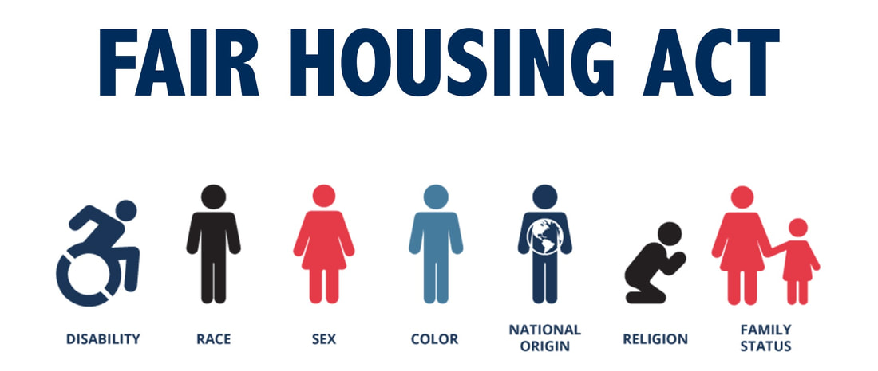
Fair Housing Protections Against Discrimination
As of January 1, 2023, Illinois landlords cannot discriminate based on tenants’ ‘sources of income.’
Notes:
In Illinois, housing providers cannot refuse to rent or sell to you, provide limited options, alter terms of the rental agreement, or in any other way give you unequal treatment because of your:

Slide 7
To File a Complaint for Discrimination under the Fair Housing Act
The Illinois Department of Human Rights - Fair Housing Division
Telephone: 312-814-6200
Email: IDHR.FairHousing@illinois.gov.
Website: https://www2.illinois.gov/DHR
Submission Form to File a Complaint for Discrimination: https://www2.illinois.gov/dhr/FilingaCharge/Pages/Housing.aspx
Chicago Regional Office of Fair Housing and Equal Opportunity- HUD
Telephone: 312-913-8453
Email: complaintsoffice05@hud.gov
Website: https://www.hud.gov/states/illinois/offices

Slide 8
Immigration Status Disclosure
Immigration Status is not a protected class under the fair housing laws, however national origin is protected.
If landlords ask about immigration status, they must ask ALL applicants.
It is illegal for landlords to require tenants to provide additional fees or documentation due to perceived national origin.
Landlords should make sure tenants understand the lease and provide it in alternate formats (i.e. written lease in Spanish)
Notes:
Many immigrant tenants have the assumption that they do not have housing rights. However, they do have a number of protections available to them. First, immigrant tenants should know that it is illegal for landlords to require additional fees and documentation… while immigration status is not a protected class under the fair housing laws, national origin is protected. Some immigrant tenants might experience discrimination based on immigration status in connection to their national origin and might be able to receive protection under the fair housing laws. Landlords should subject all applicants to the identical set of basic questions. National origin discrimination is different treatment in housing because of a person’s ancestry, ethnicity, birthplace, culture, or language. Procedures to screen potential and existing tenants for citizenship and immigration status may violate the Fair Housing Act’s prohibitions on national origin housing discrimination

Slide 9
Scenario: I applied to rent an apartment and the landlord denied my application saying “He does NOT rent to non-English speakers.”
A) Enroll in English classes and apply to another apartment later.
C) Find another landlord that speaks the same language
What should you do?
B) Contact the IL Dept. of Human Rights and file a discrimination complaint

Slide 10
Immigrant Tenant Protection Act (ITPA)
In effect since August 2019
In Illinois, landlords cannot evict tenants because of their citizenship or immigration status
Notes:
There is a housing law that provides protection specifically for immigrant tenants. It’s called…
This law was passed in August 2019 and prohibits landlords from evicting a tenant because of their immigration status.

Slide 11
How does ITPA protect immigrant tenants?
Your landlord may not threaten to call ICE (immigration), increase your rent, evict you, or shut off utilities for exercising your rights.
Protects people, of any immigration status, who are currently renting.
Protects everyone living with the tenants, not just people named on the lease.
Protects tenants with verbal lease agreements, not just written agreements.
Notes:
ITPA protects tenants in four ways…
First…

Slide 12
ITPA Limitations
It does NOT cover people applying for new housing.
It does NOT cover federally funded housing that requires landlords to check status.
Landlords may ask for information necessary for credit check before renting a unit.
Tenants must continue paying rent until they move.
Notes:
It does NOT cover people applying for new housing. Only protects you in places where you already rent or were renting in the past (as of August 2019).
It does NOT cover federally funded housing that requires landlords to check status.
Landlords may ask for information necessary for credit check before renting a unit.
Tenants must continue paying rent until they move.

Slide 13
Scenario: My landlord told us that we have to move out in 2 weeks and threatened to call ICE even though our lease doesn't end until December.
How does ITPA protect me?
A) I can contact an attorney and file a civil lawsuit, claiming discrimination.
B) I can stop paying rent and terminate my lease.
C) I can reduce my rent to reflect emotional damages.

Slide 14
Disclosure of Immigration Status to the Police
In Chicago*:
Police and city officials are prohibited from stopping, detaining, holding or arresting a person based solely on their current or perceived immigration status.
Application, survey or interview forms used for benefits or opportunities with the city MAY NOT contain questions related to immigration status and that city agencies may not maintain or share any person's citizenship or immigration status information.
In Illinois:
Provides that law enforcement officers or agencies may not inquire about or inquire into the citizenship, immigration status, or place of birth of any individual in the officer's or agency's custody who has been detained.
Police are prohibited from collaborating with ICE in the civil enforcement of immigration laws.
Law enforcement is restricted from sharing information with ICE.
*Under the city's Welcoming City Ordinance. Other cities with similar protections include Evanston, Oak Park, Calumet City and Urbana.
Notes:
Many immigrant tenants have the assumption that they do not have housing rights. However, they do have a number of protections available to them. First, immigrant tenants should know that it is illegal for landlords to require additional fees and documentation… while immigration status is not a protected class under the fair housing laws, national origin is protected. Some immigrant tenants might experience discrimination based on immigration status in connection to their national origin and might be able to receive protection under the fair housing laws. Landlords should subject all applicants to the identical set of basic questions. National origin discrimination is different treatment in housing because of a person’s ancestry, ethnicity, birthplace, culture, or language. Procedures to screen potential and existing tenants for citizenship and immigration status may violate the Fair Housing Act’s prohibitions on national origin housing discrimination

Slide 15
Tips for Interacting with Police
Stay calm. Don’t run, argue, resist, or obstruct the officer, even if you believe your rights are being violated. Keep your hands where police can see them.
If an undocumented tenant must call the police, ACLU recommends:
You do not have to consent to a search of yourself or your belongings.
You do not have to answer questions about where you were born, whether you are a U.S. citizen, or how you entered the country. Anything you tell an officer can later be used against you in immigration court.
Don’t lie or produce any false documents. Don’t sign anything without speaking with a lawyer first.
Notes:
There might be times when an immigrant tenant has to call or interact with the police. We understand that many immigrants, especially those who are undocumented, might be afraid to call the police due to lack of trust or expected negative experiences. If an undocumented tenant must call the police, lawyers recommend the following:
Governor Pritzker extended eviction moratorium in IL to September 19. The White house also announced that CDC issued eviction moratorium until end of the year but tenants need to fulfill various requirements to qualify. In both cases, the rent is still due so the support is still lacking. More is needed.
Mnuchin: Treasury to Disclose Details on Eviction Moratorium for U.S. Renters
https://www.nytimes.com/reuters/2020/09/01/us/01reuters-health-coronavirus-usa-renters.html
Here is the Centers for Disease Control and Prevention (CDC) order, which will be published in the Federal Register on September 4. That’s when it goes into effect.
Temporary Halt in Residential Evictions to Prevent the Further Spread of COVID-19
https://s3.amazonaws.com/public-inspection.federalregister.gov/2020-19654.pdf
Here is a quick and preliminary summary of what it includes:
* CDC is issuing eviction moratorium to protect public health * Authority cited: "Under 42 CFR 70.2" * Applies wherever there is not a more protective state moratorium in effect; (Which is the case in Illinois, at least through September 19) * Applies to all tenants who present a signed declaration to their LLs; * The declaration requires the tenant to state: * (i) income is less than $99,000, did not have to pay income tax in 2019, or received a stimulus check; * (ii) tenant unable to pay rent due to income loss or extraordinary out-of-pocket medical expenses; * (iii) tenant would become homeless or need to double-up if evicted; * (iv) tenant will still make partial payments ("using best efforts to make timely partial payments that are as close to the full payment as the individual’s circumstances may permit, taking into account other non-discretionary expenses); * Lasts through December 31 * Tenants can still be evicted for "reasons other than nonpayment of rent" * Criminal penalties for violations

Slide 16
What To Do if Detained
If you are arrested by the police, you have the right to have an attorney appointed by the government. You should ask for your attorney immediately.
If an undocumented tenant is detained by the police or ICE, ACLU recommends:
If you are detained by ICE or Border Patrol, you have the right to hire an attorney, but the government does not have to provide one. Ask for a list of free or low-cost alternatives.
Do say that you wish to remain silent and ask for a lawyer immediately. Do not offer explanations or excuses and do not answer questions without your lawyer. Do not say or sign anything or make any decisions without your lawyer.
Do not discuss your immigration status with anyone other than your attorney.
Notes:
There might be times when an immigrant tenant has to call or interact with the police. We understand that many immigrants, especially those who are undocumented, might be afraid to call the police due to lack of trust or expected negative experiences. If an undocumented tenant must call the police, lawyers recommend the following:
Governor Pritzker extended eviction moratorium in IL to September 19. The White house also announced that CDC issued eviction moratorium until end of the year but tenants need to fulfill various requirements to qualify. In both cases, the rent is still due so the support is still lacking. More is needed.
Mnuchin: Treasury to Disclose Details on Eviction Moratorium for U.S. Renters
https://www.nytimes.com/reuters/2020/09/01/us/01reuters-health-coronavirus-usa-renters.html
Here is the Centers for Disease Control and Prevention (CDC) order, which will be published in the Federal Register on September 4. That’s when it goes into effect.
Temporary Halt in Residential Evictions to Prevent the Further Spread of COVID-19
https://s3.amazonaws.com/public-inspection.federalregister.gov/2020-19654.pdf
Here is a quick and preliminary summary of what it includes:
* CDC is issuing eviction moratorium to protect public health * Authority cited: "Under 42 CFR 70.2" * Applies wherever there is not a more protective state moratorium in effect; (Which is the case in Illinois, at least through September 19) * Applies to all tenants who present a signed declaration to their LLs; * The declaration requires the tenant to state: * (i) income is less than $99,000, did not have to pay income tax in 2019, or received a stimulus check; * (ii) tenant unable to pay rent due to income loss or extraordinary out-of-pocket medical expenses; * (iii) tenant would become homeless or need to double-up if evicted; * (iv) tenant will still make partial payments ("using best efforts to make timely partial payments that are as close to the full payment as the individual’s circumstances may permit, taking into account other non-discretionary expenses); * Lasts through December 31 * Tenants can still be evicted for "reasons other than nonpayment of rent" * Criminal penalties for violations

Slide 17
Scenario: The police is arriving to your house because a neighbor heard someone yelling.
What should you NOT do?
A)Making sure you abide to what is being directed by the officer
B) Explain to the officer what could’ve prompted the call from their neighbor.
C) Resist, argue, obstruct the officer.

Slide 18
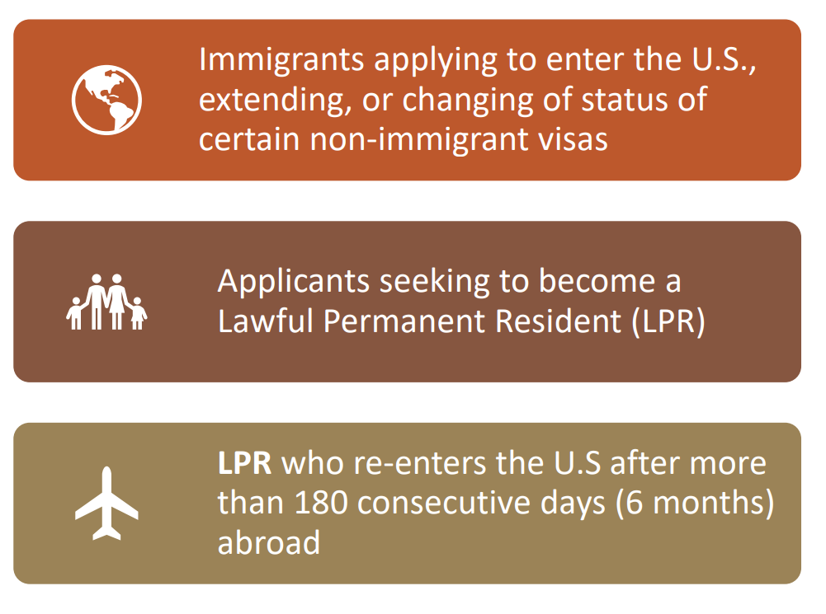
Public Charge and Housing Assistance
What is public charge?
Public Charge is part of immigration law that applies to certain immigrants seeking legal permanent status or a visa to enter the U.S, to see if they are likely to use certain public benefits in the future.
Notes:
NINA

Slide 19
Changes to the Public Charge
As of December 23, 2022, only two types of benefits programs will be considered:
Public cash assistance for income maintenance
Supplemental Security Income (SSI)
Temporary Assistance for Needy Families (TANF) - cash assistance only
State or local general assistance
Long-term institutionalization at government expense (paid for by Medicaid)
Nursing home facility or mental health institution
DOES NOT include short-term rehabilitation, imprisonment for conviction of a crime, use of home and community based services
Public benefits received by applicant’s family members (including U.S. citizen children or other relatives) will also NOT be counted for public charge.
Notes:
NINA

Slide 20
Public Housing, Assistance & Immigration Status
Undocumented immigrants are not eligible for Section 8 and federal public housing programs, but they are allowed to live with family members who are eligible.
Federal Section 8 and public housing benefits received by U.S Citizen, legal permanent residents or other eligible immigrant children and family members does not affect undocumented family members adjusting to legal status.
Rental assistance programs, housing vouchers, mortgage relief also does not affect undocumented family members adjusting their status.
Notes:
NINA

Slide 21
Free Translation and Interpretation Services
All individuals have the right to request an interpreter in any IL court when they check-in with the clerk for civil cases.
Landlords should make sure tenants understand the lease and provide it in alternate formats (i.e. provide written lease in Spanish).
If a prospective tenant brings an interpreter/translator, landlords must work with the interpreter/translator.
Roughly 16% of Chicago's population is Limited English Proficient (LEP). Chicago Housing Authority (CHA): chala@thecha.org | 312-742-8500
Notes:
Si el propietario se niega a proporcionar un contrato en un idioma determinado, puede estar violando la Ley de Vivienda Justa u otra legislación de derechos civiles, por lo que si se encuentra en esta situación, debería consultar con un abogado.
En el Tribunal de Desalojos en el Daley Center de Chicago, las personas pueden solicitar un intérprete cuando se registran con el secretario. Si no hay intérprete disponible, no está obligado a continuar con el caso.

Slide 22
Scenario: I am at court and need an interpreter, but there is not one available.
What can I do?
A) I have to continue with my case and try to understand as best as I can.
B) I can have my case rescheduled to a time when there is an interpreter available.
C) I have to pay someone to interpret for me during the case.

Slide 23
Resources
Utility Bill Assistance
Low Income Home Energy Assistance Program (LIHEAP)
September, 1st 2022 through May, 31st 2023
To apply, visit: https://dceo.illinois.gov/communityservices/utilitybillassistance
Provider: Illinois Department of Commerce & Economic Opportunity
Homeowner Assistance
Illinois Homeowner Assistance Fund (ILHAF)
November, 1st 2022 through March 31,2023
To apply, visit: https://www.illinoishousinghelp.org/ilhaf
Provider: Illinois Housing Development Authority (IHDA)
Rental Assistance
Illinois Court-Based Rental Assistance Program
October, 3rd 2022 through June 31,2023
To apply, visit: https://www.ihda.org/about-ihda/cbrap/
Provider: Illinois Housing Development Authority (IHDA)
Notes:
IHDA
The Illinois Homeowner Assistance Fund (ILHAF) is a federally funded program dedicated to assisting homeowners who are at risk of default, foreclosure, or displacement as result of a financial hardship caused by the COVID-19 pandemic. - up to $60,000 per household to pay delinquent mortgage payments, property taxes, homeowner’s insurance, association fees, mobile home lot rent November, 1st 2022 through March 31,2023
Illinois Court-Based Rental Assistance Program (CBRAP) provides funding to Illinois tenants and landlords across the state who have pending cases in eviction court. Applicants may qualify for up to $25,000 in emergency rental payments that can include up to 15 months of past-due rent and 3 months of future rent payments to prevent eviction. ***Proof of citizenship is NOT required - rental assistance is not a public charge benefit****
DOH
Rental Assistance Program (RAP) provides funding to Chicagoans who are at risk of becoming homeless due to lost income or had another eligible emergency. Assistance may include payment of future rent, or rent to prevent eviction. ***Open to all Chicago residents regardless of legal immigration status***
Illinois Department of Commerce and Economic Opportunity - Utility Bill Assistance Open September 1st, 2022 through May 31st, 2023
Low Income Home Energy Assistance Program (LIHEAP) helps eligible low-income households pay for home energy services (mainly heating but includes water). One-time assistance - ***Social security card or ITIN for residents who have them. Residents without ITIN or SSN can still apply and your Local Administering Agency will advise accordingly***

Slide 24
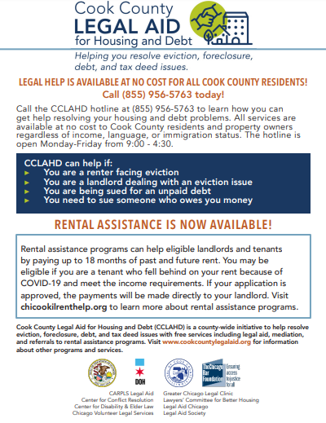
Cook County Legal Aid for Housing and Debt (CCLAHD)
Free legal help with evictions, foreclosures, debt, and property tax issues for residents of Cook County.
Phone: 855-956-5763
www.cookcountylegalaid.org
Notes:
IHDA
The Illinois Homeowner Assistance Fund (ILHAF) is a federally funded program dedicated to assisting homeowners who are at risk of default, foreclosure, or displacement as result of a financial hardship caused by the COVID-19 pandemic. - up to $60,000 per household to pay delinquent mortgage payments, property taxes, homeowner’s insurance, association fees, mobile home lot rent November, 1st 2022 through March 31,2023
Illinois Court-Based Rental Assistance Program (CBRAP) provides funding to Illinois tenants and landlords across the state who have pending cases in eviction court. Applicants may qualify for up to $25,000 in emergency rental payments that can include up to 15 months of past-due rent and 3 months of future rent payments to prevent eviction. ***Proof of citizenship is NOT required - rental assistance is not a public charge benefit****
DOH
Rental Assistance Program (RAP) provides funding to Chicagoans who are at risk of becoming homeless due to lost income or had another eligible emergency. Assistance may include payment of future rent, or rent to prevent eviction. ***Open to all Chicago residents regardless of legal immigration status***
Illinois Department of Commerce and Economic Opportunity - Utility Bill Assistance Open September 1st, 2022 through May 31st, 2023
Low Income Home Energy Assistance Program (LIHEAP) helps eligible low-income households pay for home energy services (mainly heating but includes water). One-time assistance - ***Social security card or ITIN for residents who have them. Residents without ITIN or SSN can still apply and your Local Administering Agency will advise accordingly***

Slide 25
Nina Sedeño, Immigration Policy Analyst
Latino Policy Forum
nsedeno@latinopolicyforum.org
Anna Arzuaga, Housing Policy Analyst
Latino Policy Forum
aarzuaga@latinopolicyforum.org
Contact

Slide 26
Questions?
Notes:
Si tiene preguntas o quire mas informacion por favor comuniquese conmig al… o llame a…
En este enlace puede encontra nuesta guida…. Donde puede obtener actualizaciones de politicas y recursos de Vivienda

Slide 27
Which of the following topics would you be most interested in for the next presentation/training? 1. FHA and fair housing protections 2. Eviction Process/Lockouts 3. Responsibilities and Best Practices for Landlords 4. Other (Please put in the chat)
Notes:
Si tiene preguntas o quire mas informacion por favor comuniquese conmig al… o llame a…
En este enlace puede encontra nuesta guida…. Donde puede obtener actualizaciones de politicas y recursos de Vivienda

